Slide 1


URBAN WATER QUALITY PREDICTION
Using Machine Learning
(Naive Bayes Classifier)
Smart Bridge-Remote Summer Internship Program

Slide 2

TEAM 39
SUNKARI SHRUTHI 17UK1A0570
PRATHYUSHA BURRA 17UK1A0564
SRIRAM SOWMYA 17UK1A0574
VENNA ARAVIND 17UK1A0591
Under the guidance of
K. GOUTHAM

Slide 3
ABSTRACT
Urban water quality is of great importance to our daily lives. Prediction of urban water quality help control water pollution and protect human health. In this work, we forecast the water quality of a station over the next few hours, using a multitask multi-view learning method to fuse multiple datasets from different domains. In particular, our learning model comprises two alignments. The first alignment is the spaio-temporal view alignment, which combines local spatial and temporal information of each station. The second alignment is the prediction alignment among stations, which captures their spatial correlations and performs copredictions by incorporating these correlations. Extensive experiments on real-world datasets demonstrate the effectiveness of our approach.

Slide 4
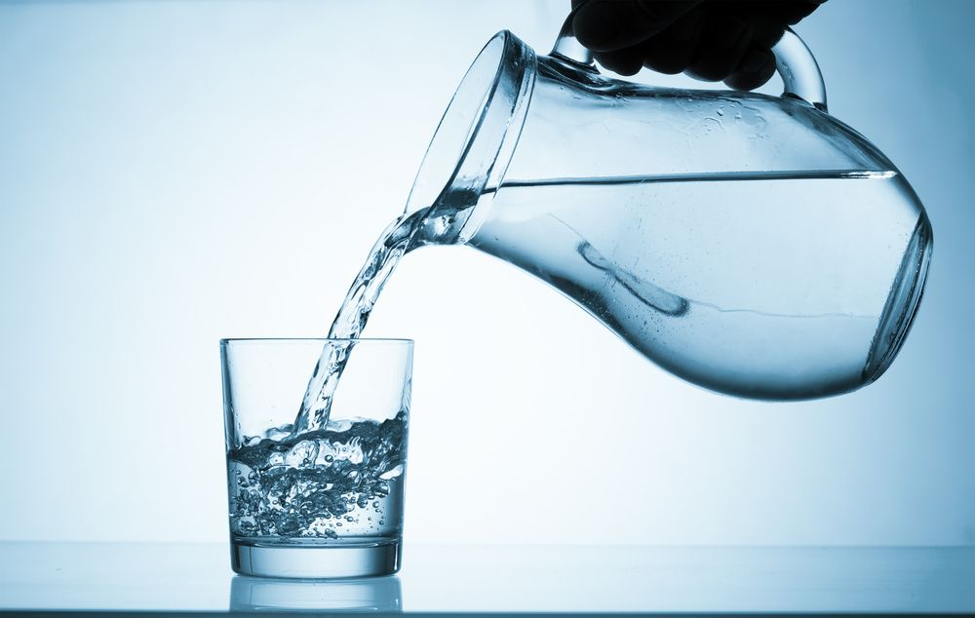
INTRODUCTION
Water quality modeling involves the prediction of water pollution of using mathematical simulation techniques.
The present study of Water Quality Prediction is based on the analysis of samples of urban water.
The water quality parameters were analysed using statistical and soft computing techniques used to predict the Water Quality.
The model has been built using data form water quality sector to predict the status of water. Six algorithms have been used to build the proposed model: Random Forest, Logistic Regression, Decision Tree, SVM, KNN Naive Bayes. By using the algorithm a Flask model has been implemented and tested.

Slide 5
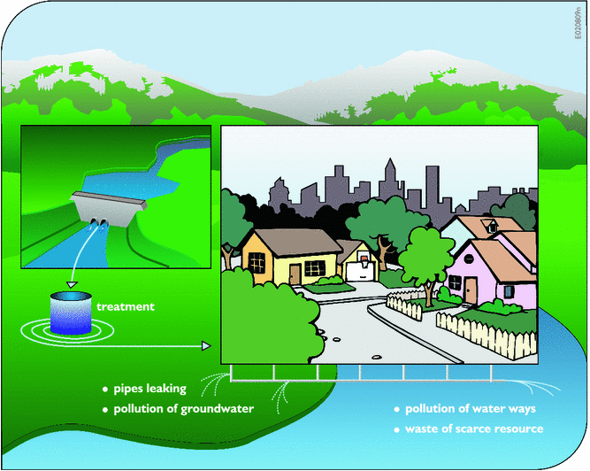
EXISTING PROBLEM
With the rapid development of economy and accelerated urbanisation, water pollution has become more and more serious. Urban water quality is of great importance to our daily lives. Prediction of urban water quality help control water pollution and protect human health. To overcome this kind of problem statement, we developed a Deep Learning model to predict the water quality.

Slide 6
PROPOSED SOLUTION & ALGORITHMS
Naive Bayes algorithm in machine learning methods which efficiently performs both classification and regression tasks. Naive Bayes is a kind of classifier which uses the Bayes Theorem. It predicts membership probabilities for each class such as the probability that given record or data point belongs to a particular class. The class with the highest probability is considered as the most likely class. And the most likely class will be the output predicted for the water quality.
And also we have created an UI using the Flask for the urban water quality prediction, this UI will allow the users to predict the loan status very easily and the User interface is user friendly not at least one complication in using the interface, and it can be used just by entering some necessary details into the UI in real time.
Therefore, understanding the problems and trends of water pollution is of great significance for the prevention and control of water pollution. We have proposed a system that uses Machine Learning Algorithms to predict the water quality in Urban & to forecast the predictions.

Slide 7
SYSTEM DESIGNING
Jupyter Notebook Environment
Spyder Ide
Machine Learning Algorithms
Python (pandas, numpy, matplotlib, seaborn, sklearn)
HTML
Flask
CSS
We developed this urban water quality prediction by using the Python language which is a interpreted and high level programming language and using the Machine Learning algorithms. for coding we used the Jupyter Notebook environment of the Anaconda distributions and the Spyder, it is an integrated scientific programming in the python language.
For creating an user interface for the prediction we used the Flask. It is a micro web framework written in Python. It is classified as a micro framework because it does not require particular tools or libraries. It has no database abstraction layer, form validation, or any other components where pre-existing third-party libraries provide common functions, and a scripting language to create a webpage is HTML by creating the templates to use in the functions of the Flask and HTML.

Slide 8
APPLICATIONS
Machine learning is a powerful tool which can be very useful when analysing environmental data, including water quality, and can form a backbone for competent AI systems which help manage and monitor water.
More accurate predictions will lead to more insightful data, empowering our customers to make better business decisions.
It is one of the most widely used areas of data mining in the water quality industry.
Due to tremendous growth in data the water quality industry deals with, analysis and transformation of the data into useful knowledge has become a task beyond human ability.
So we use Machine Learning Algorithms to analyse the quality of the water.

Slide 9
ADVANTAGES AND DISADVANTAGES
Advantages:
Easy and simple User Interface for the people who is going to evaluate the water quality.
Naive Bayes give the accurate result of the prediction up to 94% which is the algorithm we used for prediction.
It is widely used for managing risks in the water quality industry.
It is composed using the HTML and Python for the web usage in real time.
It can work in real time and predict as soon as the necessary details for prediction are given to the model.
Disadvantages:
Gives only 94% accuracy for the water quality.
It could not work anywhere like an web-application, if one is using other should be quiet.
Needs more than a single value for the prediction.

Slide 10
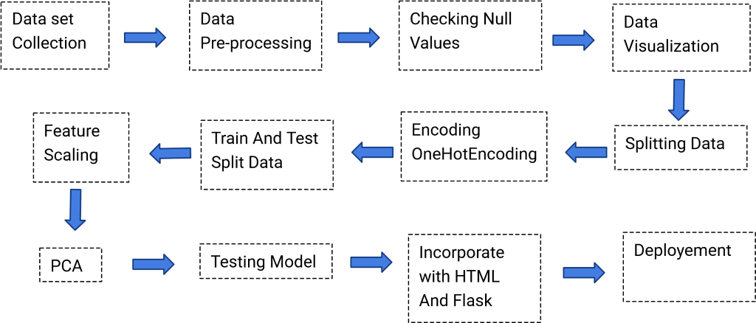
BLOCK DIAGRAM

Slide 11
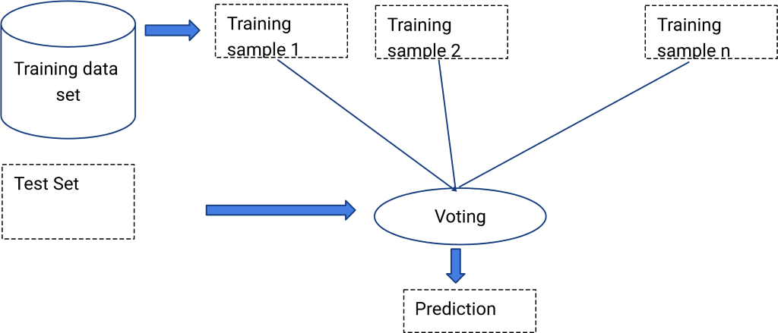
BLOCK DIAGRAM

Slide 12

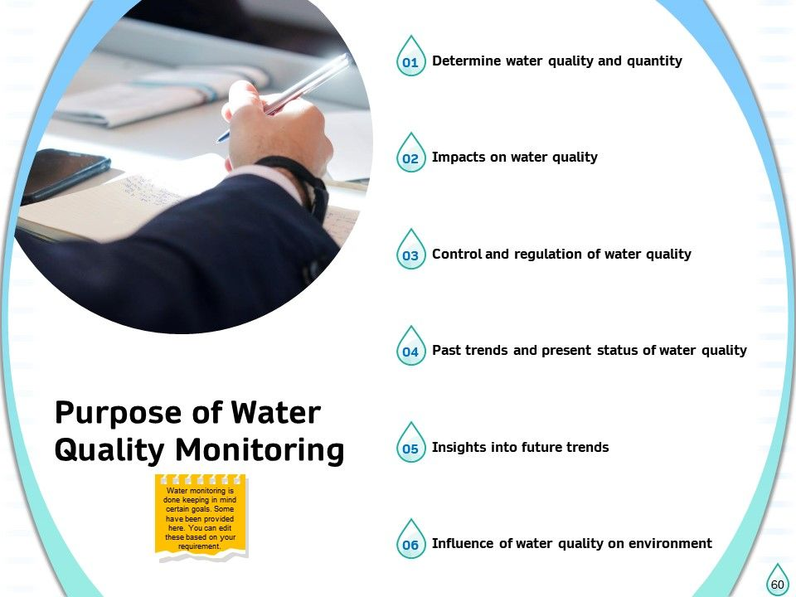

Slide 13
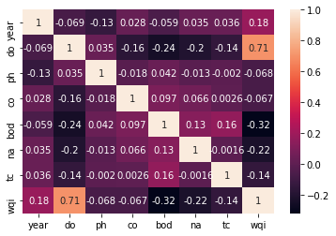
RESULT
In this paper, the Naive Bayes algorithm is used to predict its performance, and compared with another six machine learning methods namely the decision tree, the logistic regression, Random Forest and the SVM. The obtained results are displayed in Table below. But, the Random Forest Regression still perform the best with an accuracy of 94% higher than the Logistic Regression with an accuracy of 61%.
S No: | Algorithms Used | Accuracy
1 | Random Forest | 94%
2 | Decision Tree | 94%
3 | Logistic Regression | 61%

Slide 14
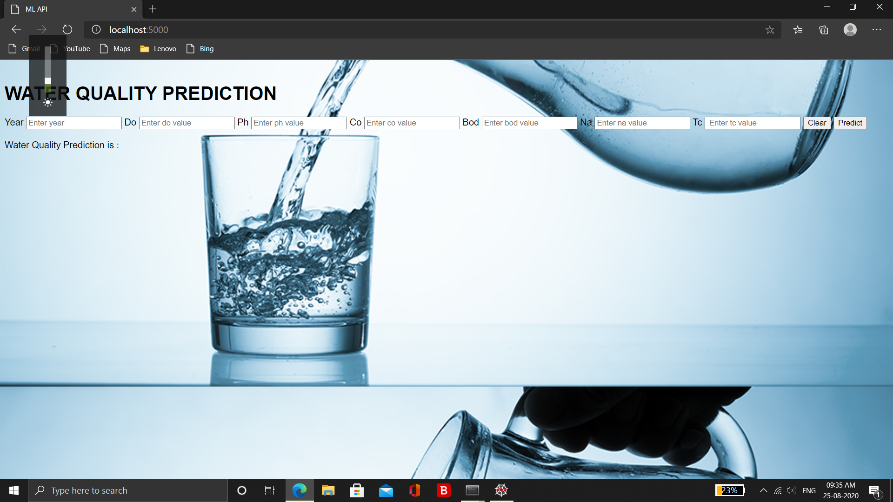
RESULT
Water quality can be predicted

Slide 15
CONCLUSION
In this paper, the Naive Bayes algorithm is adopted to build a UI model for predicting water quality default in and the results are compared with other six algorithms of logistic regression, KNN, random forest, decision tree and support vector machine. The experiment shows that the Naive Bayes algorithm performs outstanding than the other six algorithms in the prediction of water quality and has strong ability of generalization. There is no definitive guide of which algorithms to use given any situation. What may work on some data sets may not necessarily work on others. Therefore, always evaluate methods using cross validation to get a reliable estimates.

Slide 16
FUTURE SCOPE
In future the Naive Bayes algorithm can be applied on other data sets available for water quality to further investigate its accuracy. A rigorous analysis of other machine learning algorithms other than these six can also be done in future to investigate the power of machine learning algorithms for urban water quality prediction. In further study, we will try to conduct experiments on larger data sets or try to tune the model so as to achieve the state -of-art performance of the model and a great UI support system making it complete web application model.

Slide 17
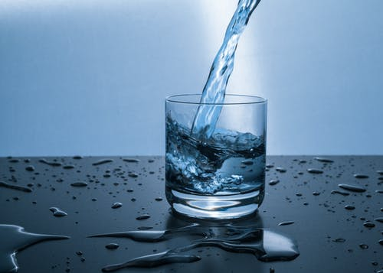
THANK YOU

